Slide 1
Advanced Games Development
Game Physics
CO2301 Games Development 1
Week 21

Slide 2
Today’s Lecture
Introduction
Collision Bodies
Physical Properties
Relationship with Scene Models
Practical Issues

Slide 3
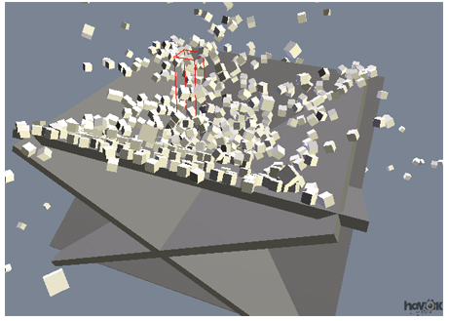
Introduction
Physics engines simulate Newtonian physics for models in a scene
  Usually a separate library
Real-time simulation of movement and interaction
The game provides the physical info about the world:
  Static: size of world, model data: mass, centre of gravity, etc.
  Dynamic: the forces acting on the models
  Relationships: joints, degrees of freedom, etc
The physics engine simulates movement / collisions based on this information

Slide 4
Existing Physics Engines
A complete physics engine is very difficult to write
  Although smaller parts are approachable, e.g. collision detection, particle physics
The core component is a program called a solver:
  Solving simultaneous Newtonian equations
  Needs precise maths and programming
Common to use existing physics engines, e.g:
  Havok: Commercial engine used widely for games
  PhysX: Hardware accelerated engine, used on games
  Bullet: Good free engine, used on some games
  ODE: Fairly powerful freeware engine
  SPE: Lightweight, free for non-commercial use
We will look at Bullet in the lab

Slide 5
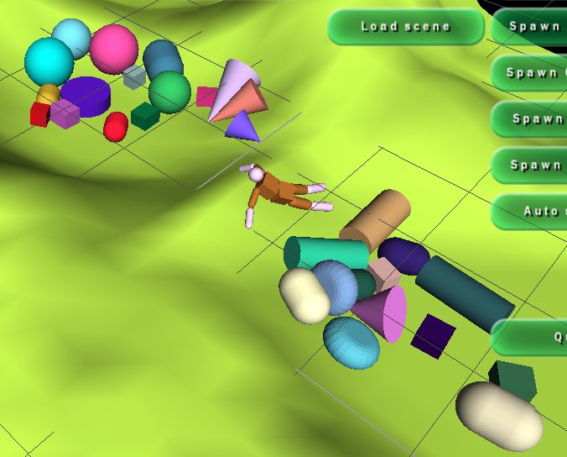
Rigid Body Simulation
Physics engines can simulate rigid or soft bodies
  Note we call them bodies not models in a physics engine
Rigid body simulation more straight-forward
  Handling deformation is difficult
Rigid bodies defined by their collision volume or shape
The collision volume is usually a simplification of the visual model
  A car may use box as a volume
  Or character as a set of boxes and cylinders
Can connect them together for more complex models

Slide 6
Collision Primitives
Can choose the physics body shape from a set of simple primitives:
  Box (or cuboid)
  Sphere (or ellipsoid)
  Cone
  Cylinder
  Rounded cylinder (capsule or chamfer)
Each is treated as a precise mathematical object rather than a polygonal mesh
This improves the speed of the engine and produces a more accurate simulation and smoother results
But simple primitives means inaccurate collision

Slide 7
Complex Collision Volumes
What if no suitable collision shape for a model, or precise collisions required?
  Can combine simple primitives, parenting as appropriate
Or can use the (convex) boundary of the polygonal mesh of a model as its collision shape
  This is called a convex hull
Using convex hulls or other high detail volumes increases time and memory required for the physics simulation
  But will increase accuracy of collision
However, detail may bring unwanted side-effects
  E.g. a polygonal cylinder will not roll as smoothly as a mathematical one, because of its flat sides

Slide 8
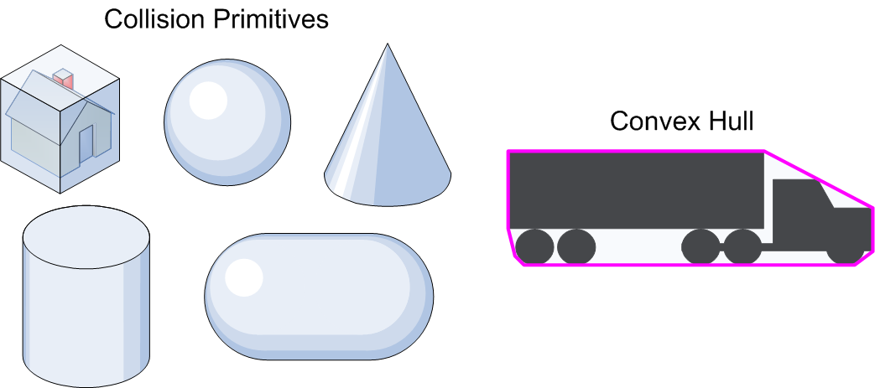
Collision Volumes

Slide 9
Physical Properties - Static
Each body in has some static physical properties:
  Mass: amount of matter (how difficult it is to move)
  Centre of gravity: point of equilibrium of a model
  Moments of inertia / inertia tensor: how mass is spread around a model (how difficult it is to rotate)
    When an object has its mass focused at its centre of gravity, it is easy to rotate it around that centre (e.g. a hammer)
    If the mass is more spread out, it is harder to rotate (e.g. flywheel)
  Elasticity: bounciness
  Friction: several types, static, kinetic, rolling
Used to apply Newton’s laws of motion
  And to calculate the effect of interactions with other physics bodies

Slide 10
Physical Properties - Dynamic
Each physics engine body also has dynamic properties
  Position and orientation
  Linear velocity: current movement
  Angular velocity: current spin
  Forces: e.g. gravity, buoyancy, wind
  Torque: “rotational force”, e.g. engine spinning an axle
  Impulses: like forces / torques with “instant” effect
  Damping: Linear and angular slowing of velocities, often used for numerical stability
Together this forms the current state of the physics world
  The initial state is set by the game, then state is dynamically updated by the physics engine

Slide 11
Physical Properties - Relationships
Bodies can be connected together
These connections usually represent joints:
  E.g. hinges, ball/socket joint, sliding joints etc.
A joint is defined by:
  The models involved in the joint
  Degrees of freedom: linear and angular, choice of these determines the joint type
  Stiffness and springiness
Several joints can be used for more complexity
  E.g. Chains, machines, rag-dolls, etc.
  Rag-doll: set of primitives connected like a human body
  Will look at joints in more detail next week

Slide 12
Physics Simulation: Initialisation
Create a rigid body in the physics engine for each model in our scene
  Choosing a suitable collision shape (or shapes)
Define the static properties for each body
  E.g. Mass, centre of gravity
Define any joints connecting bodies together
Initialise the dynamic properties
  E.g. Initial position and velocity
  Make sure to match the model position in 3D engine

Slide 13
Physics Simulation: Update
Physics simulation runs in the game loop
  Typically they use fixed timing
  E.g. update physics with a 50fps tick (every 0.02s)
  Physics engines tend to be numerically more stable with fixed timing
The game regularly updates the physics engine with changes that affect the world:
  E.g. forces, torques and impulses on the models
Each tick, physics engine calculates a new state (position, velocity etc.) for each body
The new positions of the physics bodies are copied to their scene models equivalents

Slide 14
Relationship with Scene Models
This implies an important change when working with models that are in the physics simulation
There is no need to move or rotate these models
  Although we may occasionally reposition or reset them
Instead we indicate the forces, torques and impulses acting on them
  And get their positions each frame from their physics bodies
A significant shift from previous projects
  Two views of the same data: 3D model & physics body
  Can be difficult to have precise control over a model

Slide 15
Practical Issues
Physics engines are often numerically unstable
  Results can be inaccurate/difficult to control
Also computationally expensive
  Can be very slow for complex scenes
Settings must be tweaked carefully to achieve efficient and stable results
In particular:
  Don’t calculate physics for stationary bodies
  Damp velocities so movement is easily stabilised
  Stop models when they are moving very slowly
  Limit size of “physics world” to maximise accuracy
  Plus many other tweaks and optimisations

